Slide 1
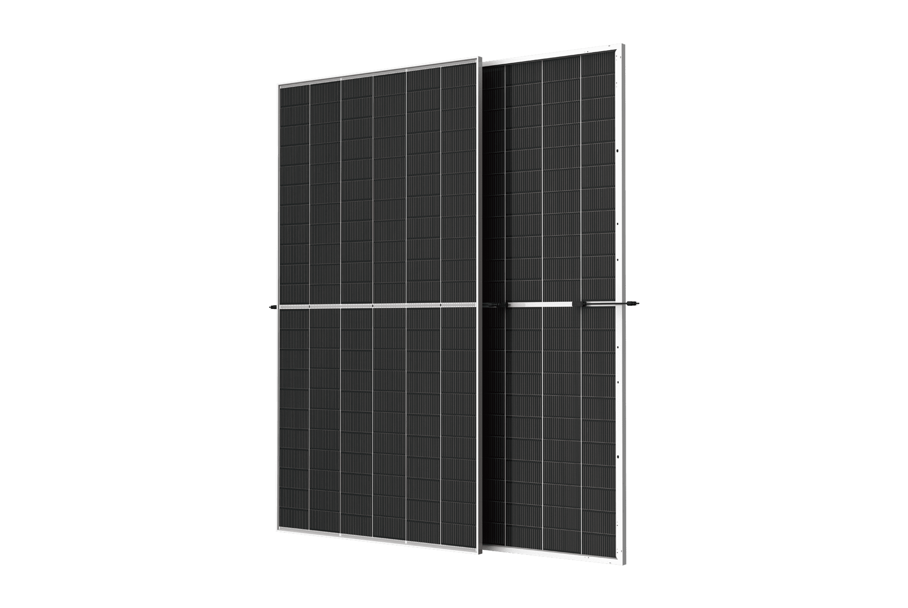










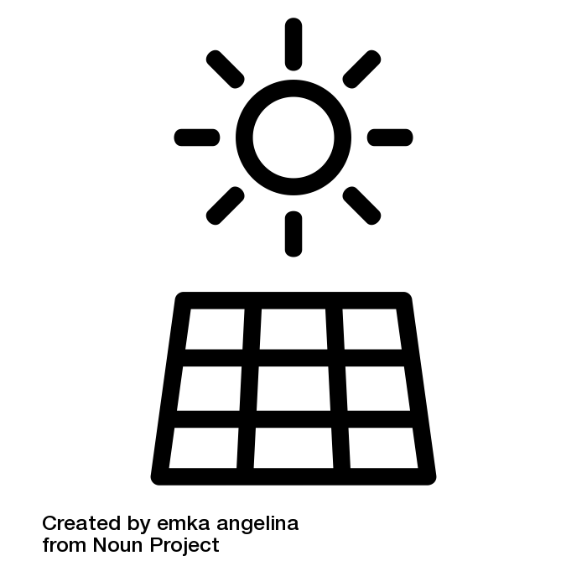

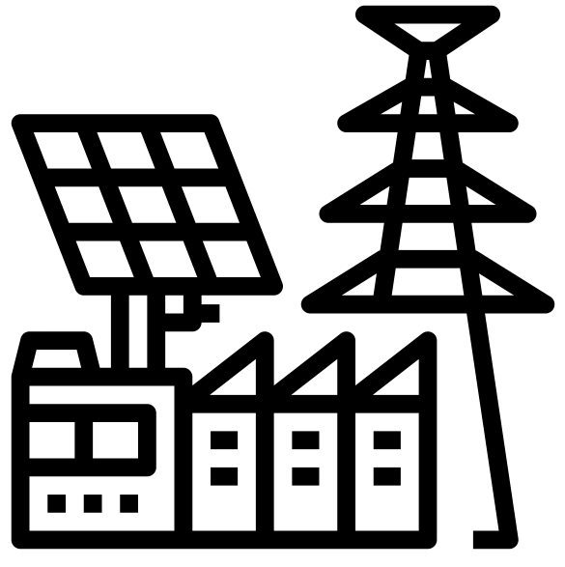








ABS-132GTS-G12R
610W – 630W
Topcon Half Cut PV Module
Glass/Transparent Back sheet-Silver Frame
630W
MAXIMUM POWER OUTPUT
+10W
OUTPUT POSITIVE TOLERANCE
Guaranteed 0~+10W positive tolerance ensures power output reliability.
23.3%
MAXIMUM EFFICIENCY
KEY FEATURES
LINEAR PERFORMANCE WARRANTY
LOW SYSTEM COST
Higher yield per surface area, lower BOS costs, higher power classes, and an efficiency rate of up to 23.30%.
100%
99%
95%
^{A}DDED VALUE FROM WARRANTY
Guaranteed Power Performance
87.40%
EXTREME WEATHER RATING
High-tech aluminum alloy frame, certified for high snow (5400 Pa) and wind loads (2400 Pa).
90%
85%
80%
1
5
10
15
20
25
30
ADVANCED MODULE TECHNOLOGY
Highest reliability & enhanced crack tolerance MBB module
Product warranty
30
Years
years
30-year Warranty for Extra Linear Power Output
ALL-WEATHER TECHNOLOGY Optimal
Yields, whatever the weather, with low-light and temperature behaviour.
Product warranty
12
Years
12-year Warranty for Materials and Processing (1st year ≤ 1.0%, 2nd~30th years ≤ 0.40% / year)
BETTER TEMPERTURE COEFFICIENT
Lower temperature coefficient (Pmax):
-0.30%/°C, increases energy yield in hot climate
THE IDEAL SOLUTION FOR
PID
ENDURING HIGH PERFORMANCE
Anti LID and Anti PID Technology. Under long-term production safety conditions, the limited power degradation caused by the PID effect is guaranteed.
Residential
Commercial
Off-Grid
Utility
COMPREHENSIVE CERTIFICATES
ADVANTAGES
IEC 61215 | IEC 61730 | IEC 61701 | IEC 62716
MADE IN UAE
Premium products are 100% made in the Emirates.
A RELIABLE INVESTMENT
Products up to 725Wp, 30 years of performance warranty.
ENCOURAGING INNOVATION
Innovative, prestigious, European production technology
UL 61730 | CEC | ISO 9001 | ISO 14001| ISO 45001
Address: Abundance Solar Panels Industries – LLC Plot No 7-8, KHIA5, KEZAD, Abu Dhabi, UAE

Slide 2
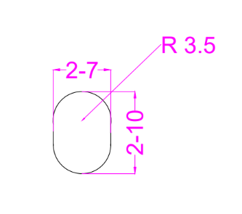


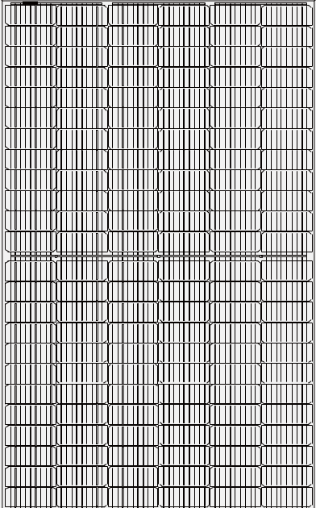
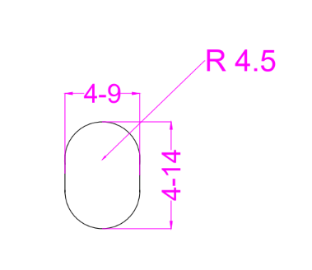
ABS-132GTS-G12R-610-630W
ENGINEERING DRAWINGS & TECHNICAL PARAMETERS
ELECTRICAL CHARACTERISTICS (STC/NOCT)
Models | Maximum Rating Power (Pmax) (W) |  | Open Circuit Voltage (Voc) (V) |  | Maximum Power Voltage (Vmp) (V) |  | Short Circuit Current (Isc) (A) |  | Maximum Power Current (Imp) (A) |  | Module Eﬃciency (EFF)(%)
 | STC | NOCT | STC | NOCT | STC | NOCT | STC | NOCT | STC | NOCT
ABS-132GTS-G12R-610 | 610 | 456.0 | 47.09 | 44.27 | 40.60 | 37.88 | 15.67 | 12.65 | 15.09 | 12.08 | 22.56%
ABS-132GTS-G12R-615 | 615 | 459.7 | 47.20 | 44.38 | 40.69 | 37.96 | 15.70 | 12.67 | 15.18 | 12.16 | 22.75%
ABS-132GTS-G12R-620 | 620 | 463.4 | 47.30 | 44.47 | 40.77 | 38.04 | 15.75 | 12.71 | 15.27 | 12.23 | 22.93%
ABS-132GTS-G12R-625 | 625 | 467.2 | 47.41 | 44.58 | 40.87 | 38.13 | 15.78 | 12.73 | 15.35 | 12.29 | 23.12%
ABS-132GTS-G12R-630 | 630 | 470.9 | 47.47 | 44.63 | 40.92 | 38.18 | 15.81 | 12.76 | 15.40 | 12.33 | 23.30%
*Standard Test Condition (STC): Cell Temperature 25 °C, Irradiance 1000 W/m², AM 1.5, Nominal module operating temperature (NMOT): Air mass AM 1.5, Irradiance 800W/m², temperature 20°C, windspeed 1 m/s. Reduction in eﬃciency from 1000W/m² to 200W/m² at 25°C: 3.5 ± 2%. *Values without tolerance are typical numbers. Measurement tolerance: ± 3%```
BI-FACIAL OUTPUT-BACKSIDE POWER GAIN
Models |  | ABS-132GTS-G12R-610 | ABS-132GTS-G12R-615 | ABS-132GTS-G12R-620 | ABS-132GTS-G12R-625 | ABS-132GTS-G12R-630
10% | Power | 671 | 677 | 682 | 688 | 693
 | Eff | 24.82% | 25.02% | 25.23% | 25.43% | 25.63%
15% | Power | 702 | 707 | 713 | 719 | 725
 | Eff | 25.95% | 26.16% | 26.37% | 26.59% | 26.80%
20% | Power | 732 | 738 | 744 | 750 | 756
 | Eff | 27.08% | 27.30% | 27.52% | 27.74% | 27.96%
25% | Power | 763 | 769 | 775 | 781 | 788
 | Eff | 28.20% | 28.44% | 28.67% | 28.90% | 29.13%
Solar Cell | Topcon 182 x 105 mm G12R ,16BB
No.of cells | 132 (6×22)
Dimensions | 2384 mm x 1134 mm x 30 mm ( 93.85” x 44.64“ x 1.18” inch)
Weight | 29 kg / 63.94 lbs.(±3%)
Front Glass | 3.20 mm, High Transmission, Low Iron, Tempered ARC Glass
Cell Encapsulation | EPE(Expanded polyethylene) & EVA (Ethylene-Vinyl-Acetate)
Back Sheet | Transparent Back sheet
Frame | Silver Anodized Aluminum Alloy Type 6005T6 , Silver Color
Junction Box | IP68, 1500VDC, 3 Bypass Diodes
Connectors Type | IP68 MC4 Compatible
Cable | 400mm or 1300 mm, 4mm²
Package Conﬁguration | 36 pcs Per Pallet, 720 pcs per 40’ FT container ( Two pallets=One stack )
CURRENT-VOLTAGE CURVE UNDER DIFFERENT IRRADIANCE

